Slide 1
Image-to-Image Translation with Conditional Adversarial Networks
Phillip Isola, Jun-Yan Zhu, Tinghui Zhou, Alexei A. Efros. arXiv, Nov. 2016
[GitHub][arXiv][Demo]
Presenter: Yifei Fan

Slide 2
Outline
WHAT
is the research problem?
HOW
did they manage to handle the task?
experiments and evaluations
WHY
explanation on the performance

Slide 3
WHAT
Image-to-image translation
Translating one possible representation of a scene into another
Common framework for predicting pixels from pixels

Slide 4
Image-to-Image Translation
GitHub
Demo
Notes:
A picture is worth a thousand words

Slide 5
Previous work
[7, 15, 11, 1, 3, 37, 21, 26, 9, 42, 46]
Need to Hand-engineer mapping functions
Our conditional GAN is different in that the loss is learned, and can, in theory, penalize any possible structure that differs between output and target.
Nothing is application-specific

Slide 6
HOW
Improved Conditional Generative Adversarial Network (cGAN)
Experiments and Evaluations

Slide 7
Improvements on cGAN for Image Translation
Objective function
Architecture of the generator
PatchGAN

Slide 8
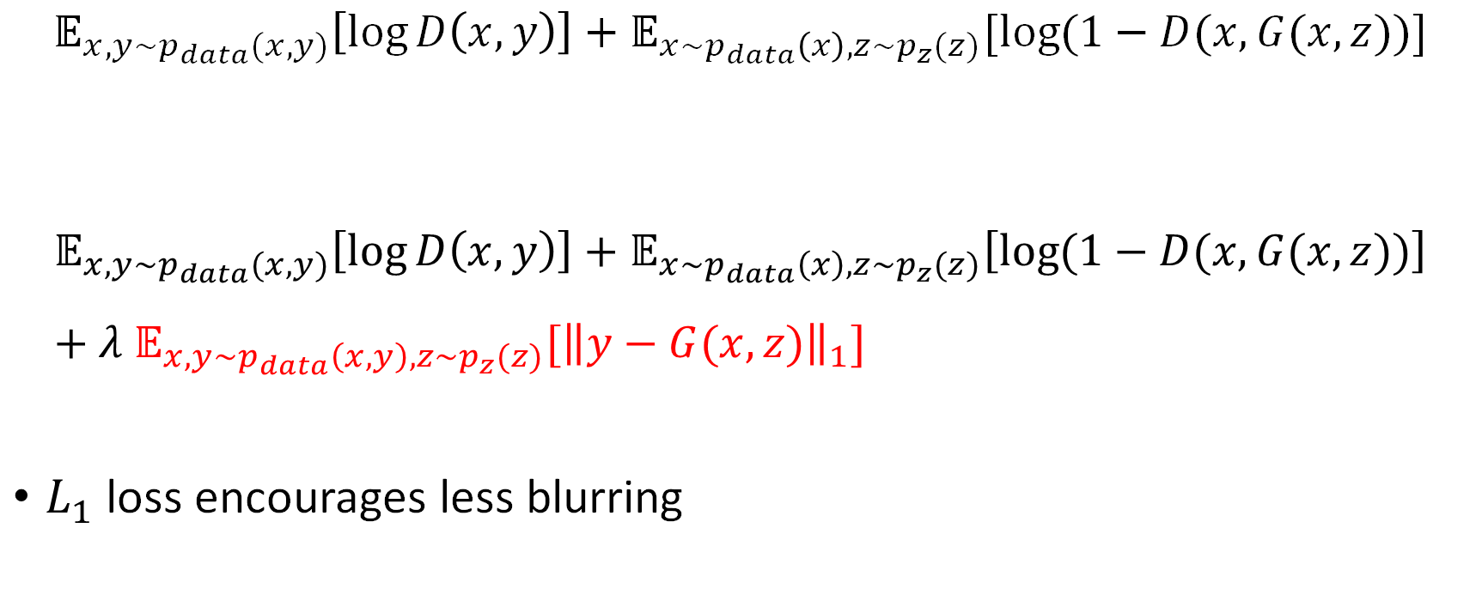
Objective Function
$$𝔼_{x,y\sim p_{data}(x,y)}\left[\log{D\left(x,y\right)}\right]+𝔼_{x\sim p_{data}\left(x\right),z\sim p_{z}(z)}[\log{(1−D(x,G(x,z))}]$$
$$𝔼_{x,y\sim p_{data}(x,y)}\left[\log{D\left(x,y\right)}\right]+𝔼_{x\sim p_{data}\left(x\right),z\sim p_{z}(z)}\left[\log{(1−D(x,G(x,z))}\right]+λ 𝔼_{x,y\sim p_{data}\left(x,y\right),z\sim p_{z}(z)}[{\left\|y−G(x,z)\right\|}_{1}]$$
$L_{1}$ loss encourages less blurring

Slide 9
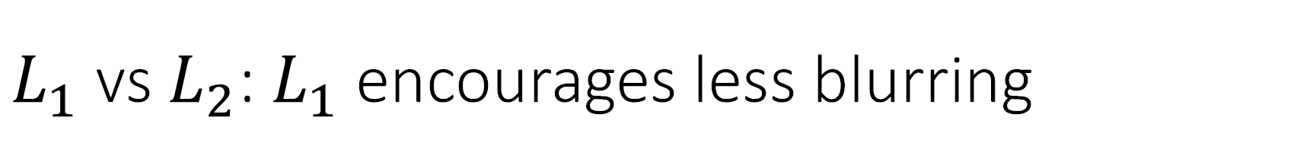
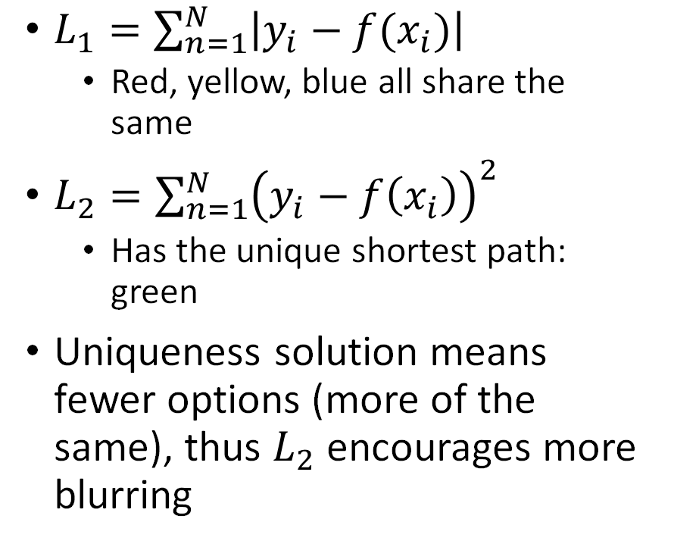
$L_{1}$ vs $L_{2}$: $L_{1}$ encourages less blurring
$L_{1}=\sum_{n=1}^{N}{\left|y_{i}−f(x_{i})\right|}$
Red, yellow, blue all share the same
$L_{2}=\sum_{n=1}^{N}{{\left(y_{i}−f\left(x_{i}\right)\right)}^{2}}$
Has the unique shortest path: green
Uniqueness solution means fewer options (more of the same), thus $L_{2}$ encourages more blurring
Reference:
http://www.chioka.in/differences-between-the-l1-norm-and-the-l2-norm-least-absolute-deviations-and-least-squares/
Notes:
The authors did not claim or prove this, they might have tried both and found that $L_{1}$ results in less blurring.
Suppose you are required to move from the bottom left to upper right in 12 steps, and minimize the $L_{1}$, $L_{2}$ distance between each step.

Slide 10
Architecture of the generator
U-Net
Shuttle low-level information directly across the net
U-Net from [34]
Notes:
U-Net: contracting path (left-side) + expansive path (right side). At each downsampling step we double the number of feature channels. Every step in the expansive path consists of an upsampling of the feature map followed by a 2x2 convolution that halves the number of feature channels, a concatenation with the corresponding cropped feature map from the contracting path, and two 3x3 convolutions, each followed by a ReLU.

Slide 11
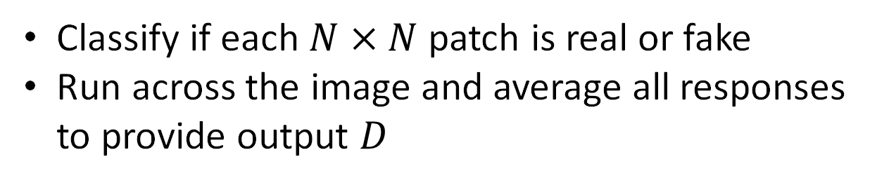
PatchGAN
Classify if each $N×N$ patch is real or fake
Run across the image and average all responses to provide output $D$
Slide by Xavier Giro:
https://www.slideshare.net/xavigiro/imagetoimage-translation-with-conditional-adversarial-nets-upc-reading-group?from_action=save
Notes:
This might come from the thought of Coarse-to-fine or scale-space theory
Committee

Slide 12
Experiments
Semantic labels↔photo, trained on the Cityscapes dataset [4].
Architectural labels→photo, trained on the CMP Facades dataset [31].
Map↔aerial photo, trained on data scraped from Google Maps.
BW→color photos, trained on [35].
Edges→photo, trained on data from [49] and [44]; binary edges generated using the HED edge detector [42] plus postprocessing.
Sketch→photo: tests edges→photo models on human-drawn sketches from [10].
Day→night, trained on [21].

Slide 13
Evaluation Metrics
AMT perceptual studies
FCN-score
Use pre-trained semantic classifiers to measure the discriminability of the generated images as a pseudo-metric.
If generated images are realistic, classifiers trained on real images will be able to classify the synthesized image correctly as well
Section 3.2 – 3.4: analysis of the performance w.r.t. the three improvements
Results
Notes:
Controlled manner

Slide 14
WHY
Discussion on the performance

Slide 15
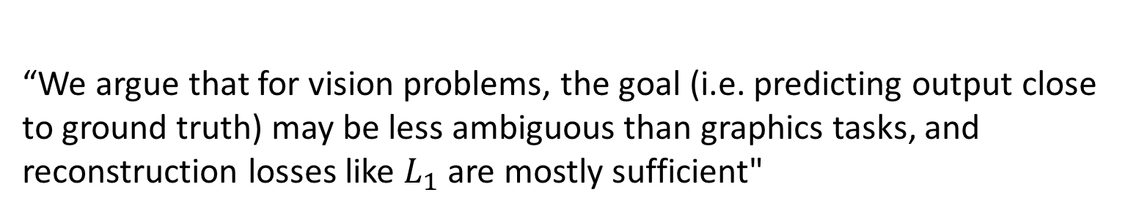
Ambiguity of Tasks
“We argue that for vision problems, the goal (i.e. predicting output close to ground truth) may be less ambiguous than graphics tasks, and reconstruction losses like $L_{1}$ are mostly sufficient"

Slide 16
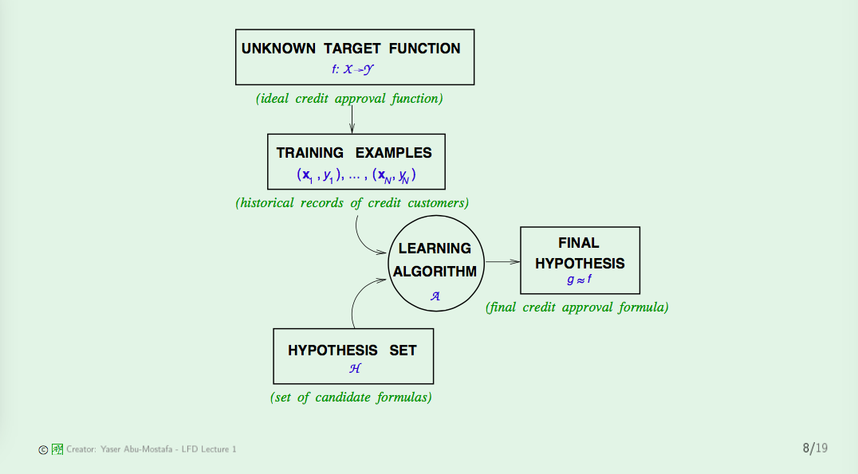
Machine Learning Framework
Slide from Professor Yaser Abu-Mostafa
http://work.caltech.edu/slides/slides01.pdf

Slide 17
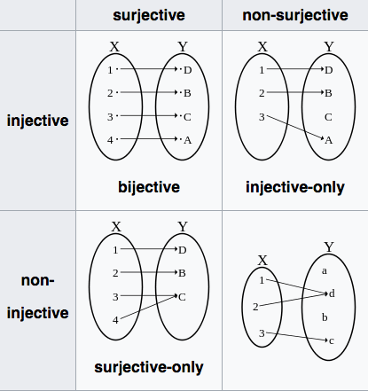
What is a function?
“A relation between a set of inputs and a set of permissible outputs with the property that each input is related to exactly one output” (from wikipedia)
Human beings are extremely good at handling relation (Facebook, LinkedIn, etc..),
Computers (arithmetic logic units) only work with functions

Slide 18
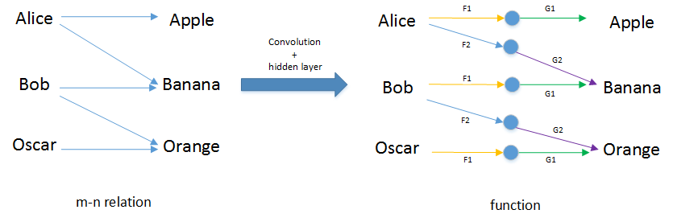
From relation to function
$F_{1}∘G_{1}(p)$: find the fruit that starts with the same letter as your name
Notes:
In a mathematic point of view, the essence of a deep network is to convert a “m-n” relationship to function, which is manageable by computers.

Slide 19
Ambiguity measurement
Measures the dissimilarity between the problem/task and a mathematic function, w.r.t. the uniqueness of your output for a given input.
Tasks with lower ambiguity tend to work better.
Performance
classification
segmentation
detection
Image translation
cross modality
generative task
Ambiguity
Notes:
In the follow up work: “We also observe a lingering gap between the results achievable with paired training data and those achieved by our unpaired method”
Tasks like classification, segmentation, detection tends to have unique output for each input, unless you’re using the hybrid images we obtained in project 1 last semester.

Slide 20
Computation

Slide 21
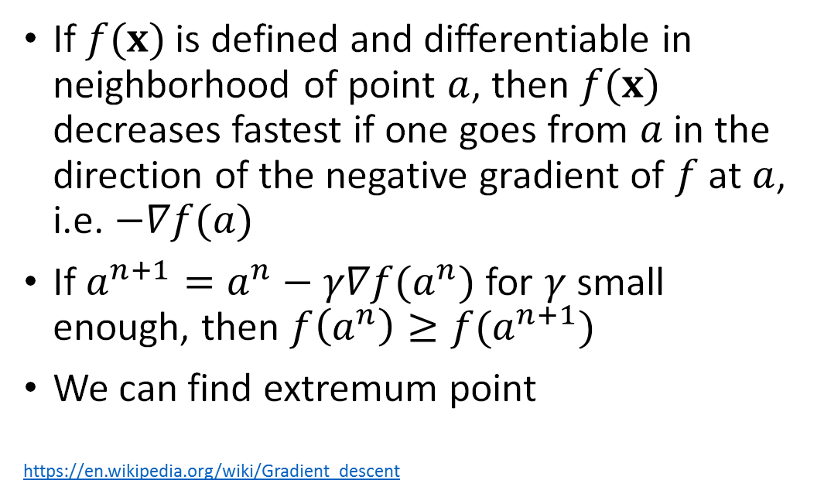
Gradient Descent
If $f(x)$ is defined and differentiable in neighborhood of point $a$, then $f(x)$ decreases fastest if one goes from $a$ in the direction of the negative gradient of $f$ at $a$, i.e. $−∇f(a)$
If $a^{n+1}=a^{n}−γ∇f(a^{n})$ for $γ$ small enough, then $f\left(a^{n}\right)≥f(a^{n+1})$
We can find extremum point
https://en.wikipedia.org/wiki/Gradient_descent

Slide 22

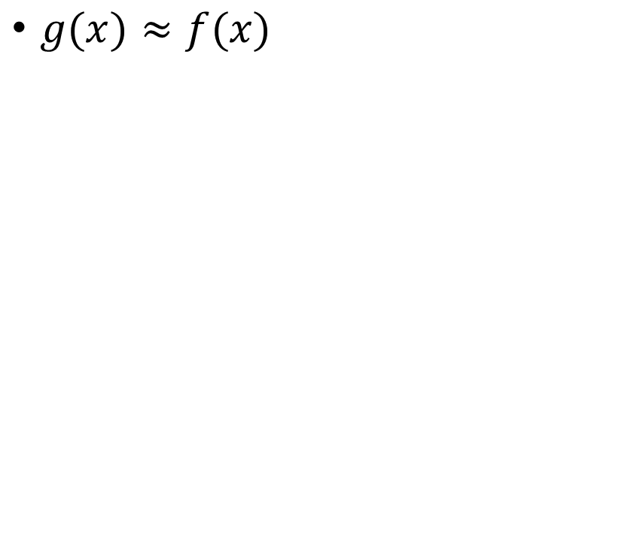
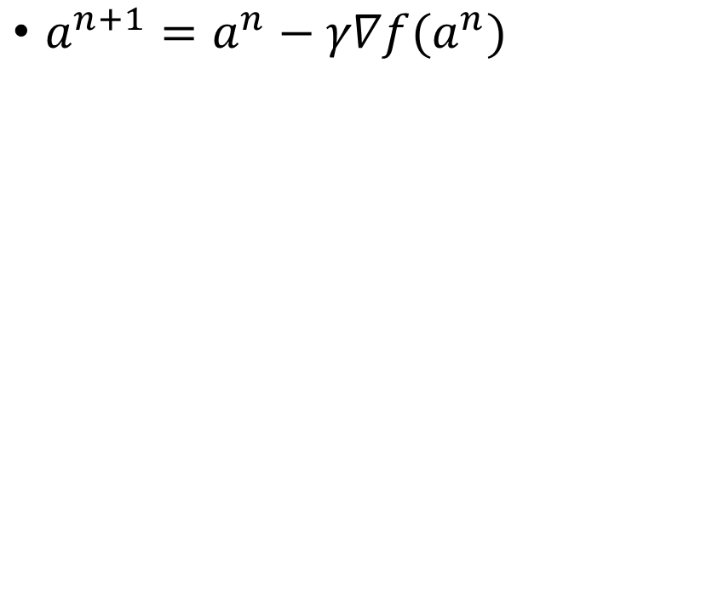
Gradient Descent in Machine Learning
$g(x)≈f(x)$
$a^{n+1}=a^{n}−γ∇f(a^{n})$
These two $f(x)$ are different!

Slide 23
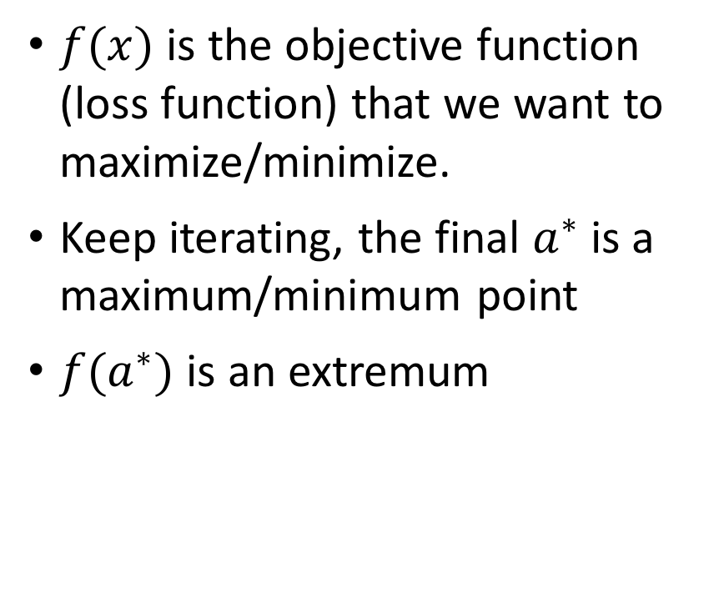
Gradient Descent in Machine Learning
$f(x)$ is the objective function (loss function) that we want to maximize/minimize.
Keep iterating, the final $a^{∗}$ is a maximum/minimum point
$f(a^{∗})$ is an extremum
$a^{n+1}=a^{n}−γ∇f(a^{n})$

Slide 24
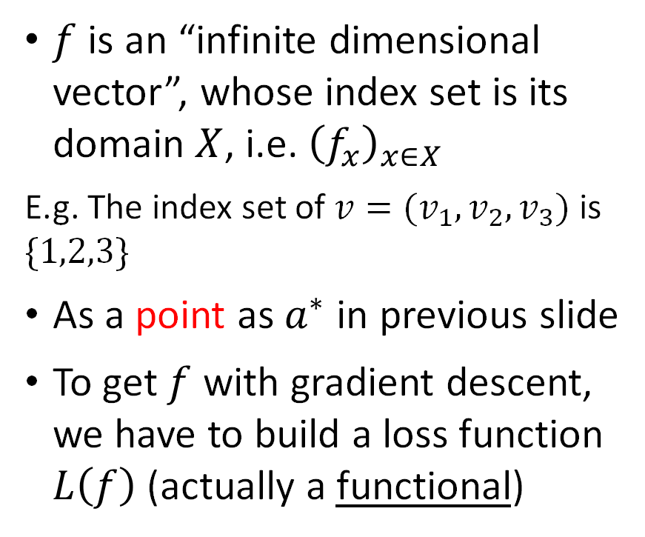
Gradient Descent in Machine Learning
$g(x)≈f(x)$
$f$ is an “infinite dimensional vector”, whose index set is its domain $X$, i.e. ${\left(f_{x}\right)}_{x∈X}$
E.g. The index set of $v=(v_{1},v_{2},v_{3})$ is $\{1,2,3\}$
As a point as $a^{∗}$ in previous slide
To get $f$ with gradient descent, we have to build a loss function $L\left(f\right)$ (actually a functional)
Notes:
example for functional $E=\int_{0}^{1}{f\left(x\right) dx}$ is a function of $f$, not $x$

Slide 25
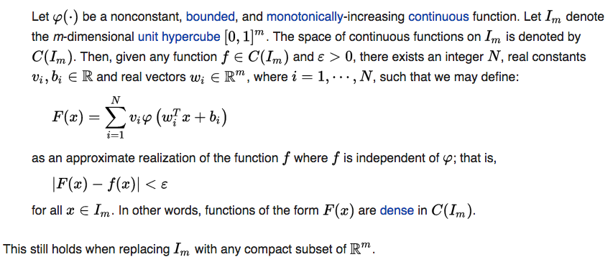

Discretization of $f$
Universal approximation theorem
In our words: $f$ can be approximated with deep networks (infinite to finite)
Notes:
This also suggests that ”deep” is preferred, as it means more terms, which tends to be more accurate. Recall Taylor series expansion.

Slide 26
What is missing in Discretization?
Notes:
Most of the tutorials on neural networks discretize the function right after introducing the idea of gradient descent.
The advantage is to make it computable. But we also lose sight of the fact that the problem is two fold: first design a loss function that fully represents the need of your task, then solve for the extremum of that loss function to obtain your target function.

Slide 27
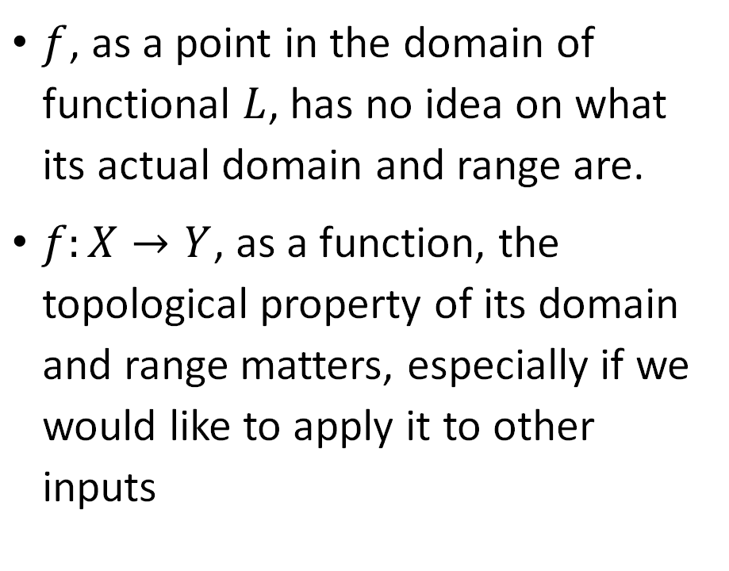

Function-Point Duality
$f$, as a point in the domain of functional $L$, has no idea on what its actual domain and range are.
$f:X→Y$, as a function, the topological property of its domain and range matters, especially if we would like to apply it to other inputs
Can $x$ or $y$ take arbitrary values?
Notes:
Si Chen’s post: your output depends on having a good input

Slide 28
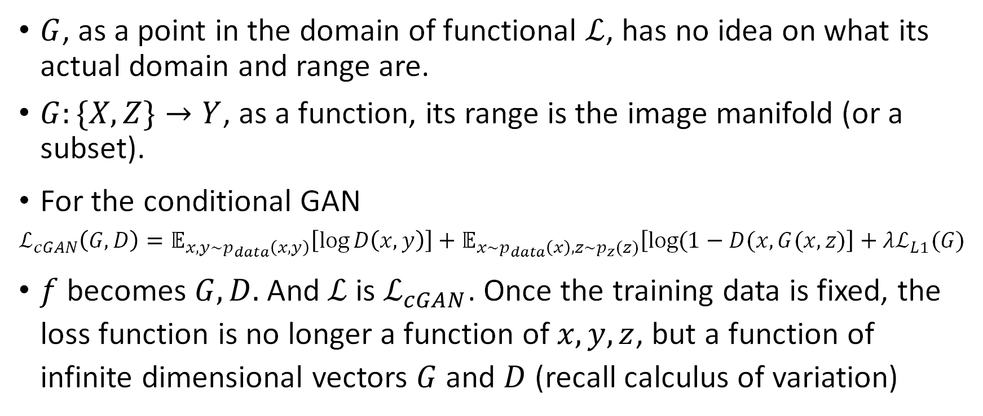
Potential Problem
$G$, as a point in the domain of functional $ℒ$, has no idea on what its actual domain and range are.
$G:\{X,Z\}→Y$, as a function, its range is the image manifold (or a subset).
For the conditional GAN
$$ℒ_{cGAN}\left(G,D\right)=𝔼_{x,y\sim p_{data}\left(x,y\right)}\left[\log{D\left(x,y\right)}\right]+𝔼_{x\sim p_{data}\left(x\right),z\sim p_{z}(z)}\left[\log{(1−D(x,G(x,z)}\right]+λℒ_{L1}(G)$$
$f$ becomes $G,D.$And $ℒ$ is $ℒ_{cGAN}$. Once the training data is fixed, the loss function is no longer a function of $x, y,z$, but a function of infinite dimensional vectors $G$ and $D$ (recall calculus of variation)
Notes:
For z, you can treat them as random but also “fixed” after a random generation, i.e. generated all together at the beginning and then grab one for each x, since there is no interference between each z

Slide 29
But what is the image manifold? Does each output fall on the image manifold?

Slide 30
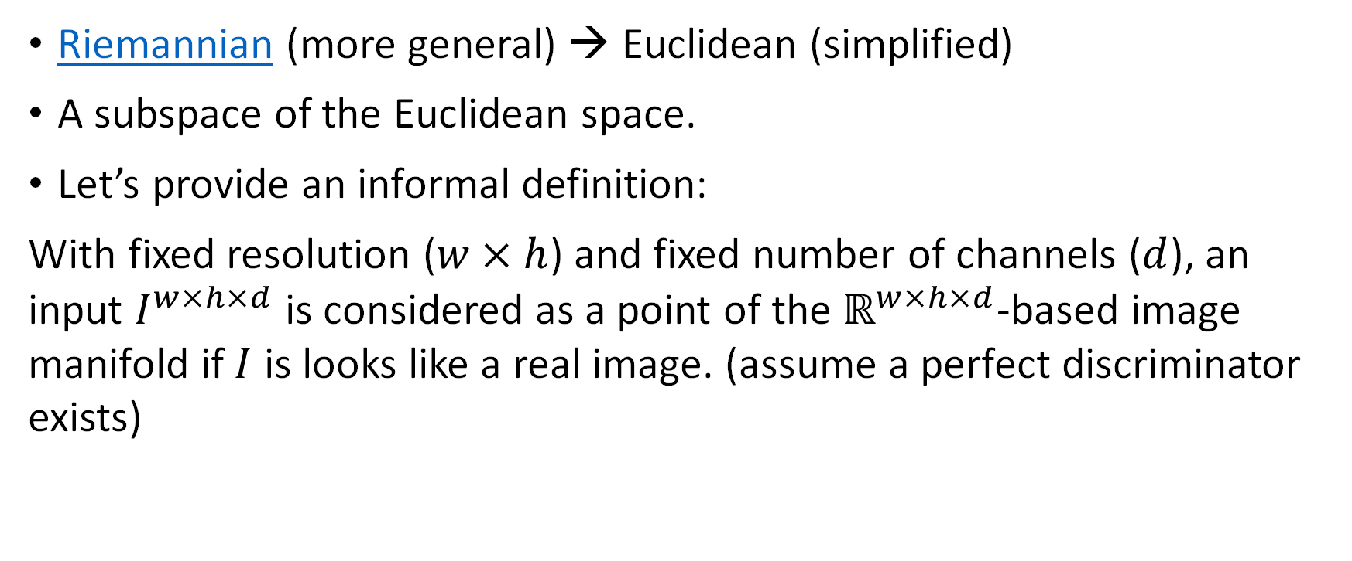
What is the Image Manifold?
Riemannian (more general) → Euclidean (simplified)
A subspace of the Euclidean space.
Let’s provide an informal definition:
With fixed resolution ($w×h$) and fixed number of channels ($d$), an input $I^{w×h×d}$ is considered as a point of the $ℝ^{w×h×d}$-based image manifold if $I$ is looks like a real image. (assume a perfect discriminator exists)

Slide 31
What does the image manifold look like?

Slide 32
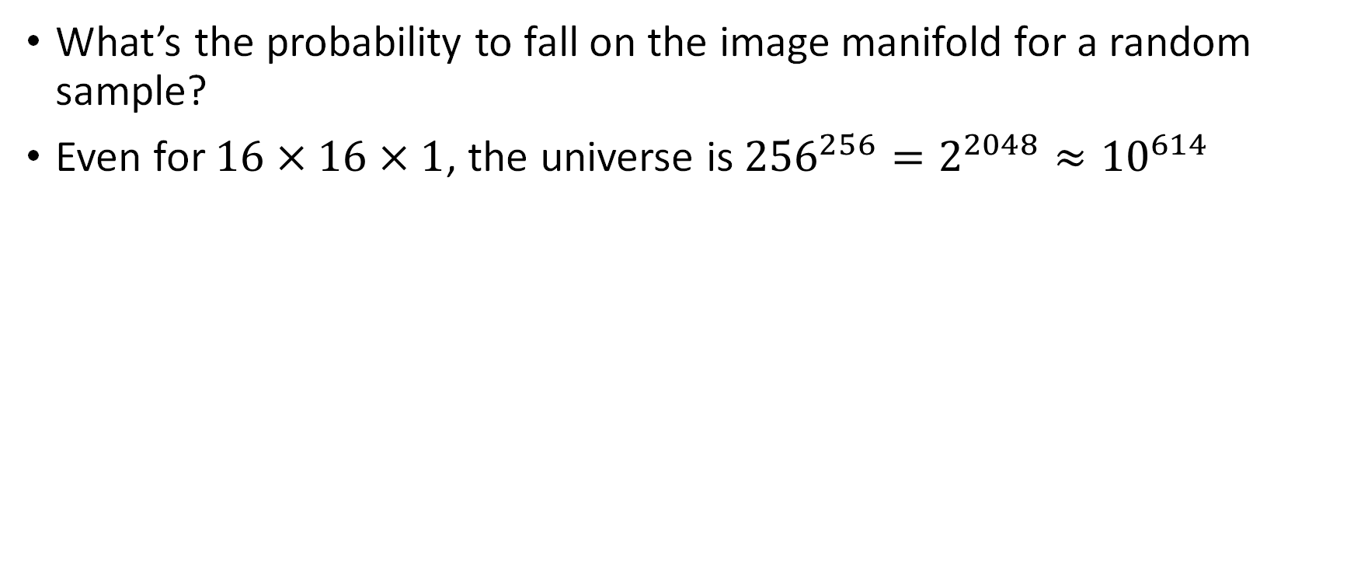
The sparsity
What’s the probability to fall on the image manifold for a random sample?
Even for $16×16×1$, the universe is ${256}^{256}=2^{2048}≈{10}^{614}$
“The emptiness is normal, the richness of the images’ neighborhood is the exception”
---- adapted from Powers of Ten
Real images are stars in the universe

Slide 33

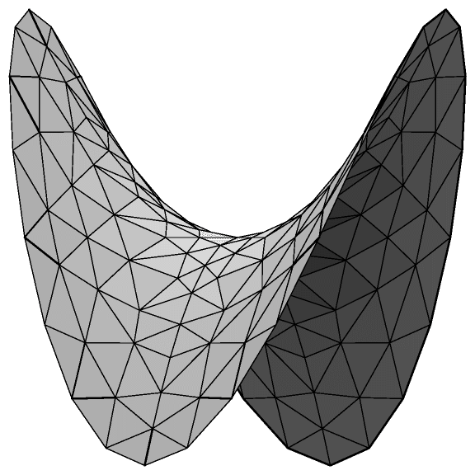
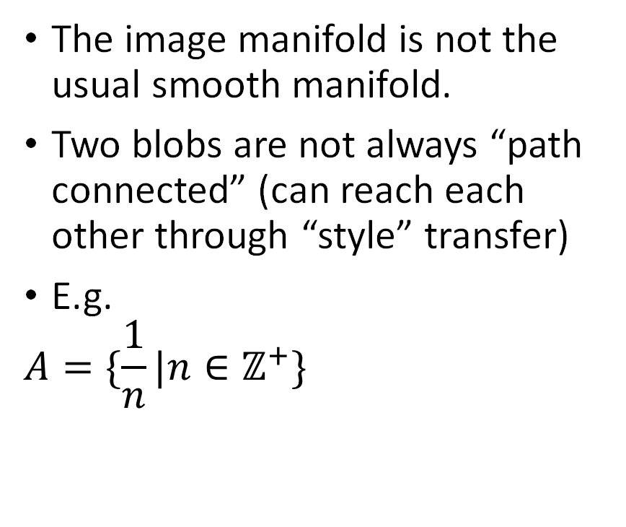
The connectivity
The image manifold is not the usual smooth manifold.
Two blobs are not always “path connected” (can reach each other through “style” transfer)
E.g.
$$A=\{\frac{1}{n}|n∈ℤ^{+}\}$$
Source of the manifold image: https://people.eecs.berkeley.edu/~efros/courses/AP06/presentations/ThompsonDimensionalityReduction.pdf
Notes:
Here “path connected” is not the rigorous one used in algebraic topology, it refers to two blobs that can be connected through a style transfer.
We can view the right model in this way: suppose the center of each blob is a image, the blob around it corresponds to the image set that generated by the center image, either through tweaking, transferring, etc.. The key here is to illustrate the fact that you may not be able to transfer an image to an arbitrary image. In most of the cases, you can’t, since there are gap zones between the blobs.
You have to be very careful doing interpolation on image manifold.

Slide 34
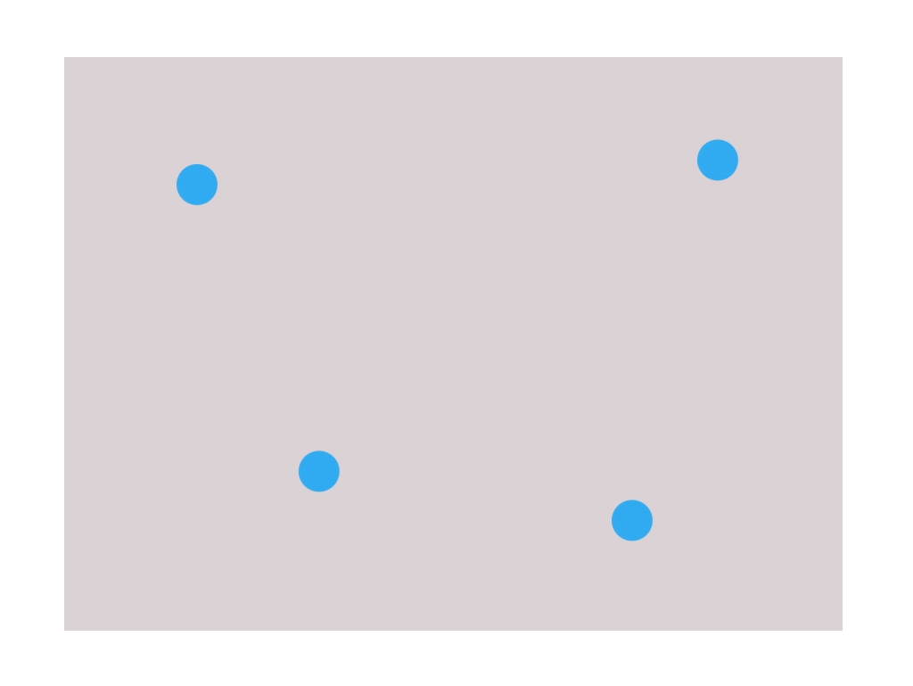
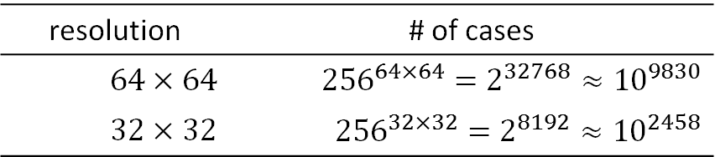
The scale-space effect
With same amount of images, lower resolution would result in a more “compact” image manifold
Human eyes are less sensitive at lower resolutions.
E.g. grayscale images
resolution | # of cases
$$64×64$$ | $${256}^{64×64}=2^{32768}≈{10}^{9830}$$
$$32×32$$ | $${256}^{32×32}=2^{8192}≈{10}^{2458}$$
Notes:
More compact, less sensitive → higher probability that a random point would fall on the image manifold.
If you apply even stronger rules on color like facades and google maps, the manifold becomes more compact

Slide 35
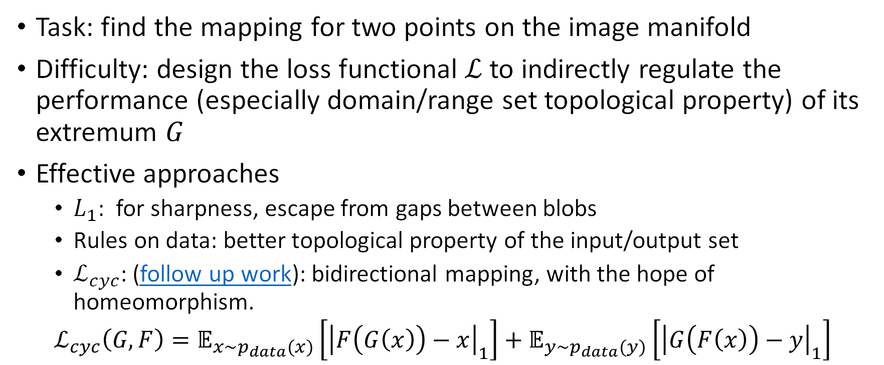
“Reinterpretation” of the work
Task: find the mapping for two points on the image manifold
Difficulty: design the loss functional $ℒ$ to indirectly regulate the performance (especially domain/range set topological property) of its extremum $G$
Effective approaches
$L_{1}$: for sharpness, escape from gaps between blobs
Rules on data: better topological property of the input/output set
$ℒ_{cyc}$: (follow up work): bidirectional mapping, with the hope of homeomorphism.
$$ℒ_{cyc}\left(G,F\right)=𝔼_{x\sim p_{data}(x)}\left[{\left|F\left(G\left(x\right)\right)−x\right|}_{1}\right]+𝔼_{y\sim p_{data}(y)}\left[{\left|G\left(F\left(x\right)\right)−y\right|}_{1}\right]$$
Notes:
The idea of CycleGAN is quite classic. To evaluate the quality of a translation, you do a cycle translation to see if you can still get something meaningful in your original domain.

Slide 36

Cycle Test without $L_{cyc}$
 | 1st round | 2nd round | 3rd round
cityscapes | Image2label | Image2label | Image2label
 | label2image | label2image | label2image
maps | map2sat | map2sat
 | sat2map | sat2map

Slide 37
Questions

Slide 38
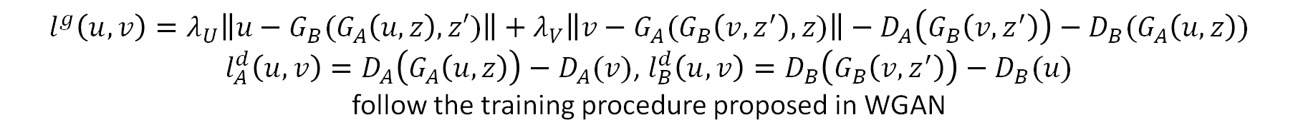
DualGAN
$$l^{g}\left(u,v\right)=λ_{U}\left\|u−G_{B}(G_{A}\left(u,z\right),z′)\right\|+λ_{V}\left\|v−G_{A}(G_{B}\left(v,z^{′}\right), z)\right\|−D_{A}\left(G_{B}\left(v,z^{′}\right)\right)−D_{B}(G_{A}\left(u,z\right))$$
$l_{A}^{d}\left(u,v\right)=D_{A}\left(G_{A}\left(u,z\right)\right)−D_{A}(v)$, $l_{B}^{d}\left(u,v\right)=D_{B}\left(G_{B}\left(v,z^{′}\right)\right)−D_{B}(u)$
follow the training procedure proposed in WGAN
Notes:
For generator, the DualGAN use what suggested by WGAN
Slight difference in the loss function: for DualGAN, it measures the difference in the discriminator’s judgment whereas for CycleGAN it comes the distance between the original and the reconstructed image

